Slide 1
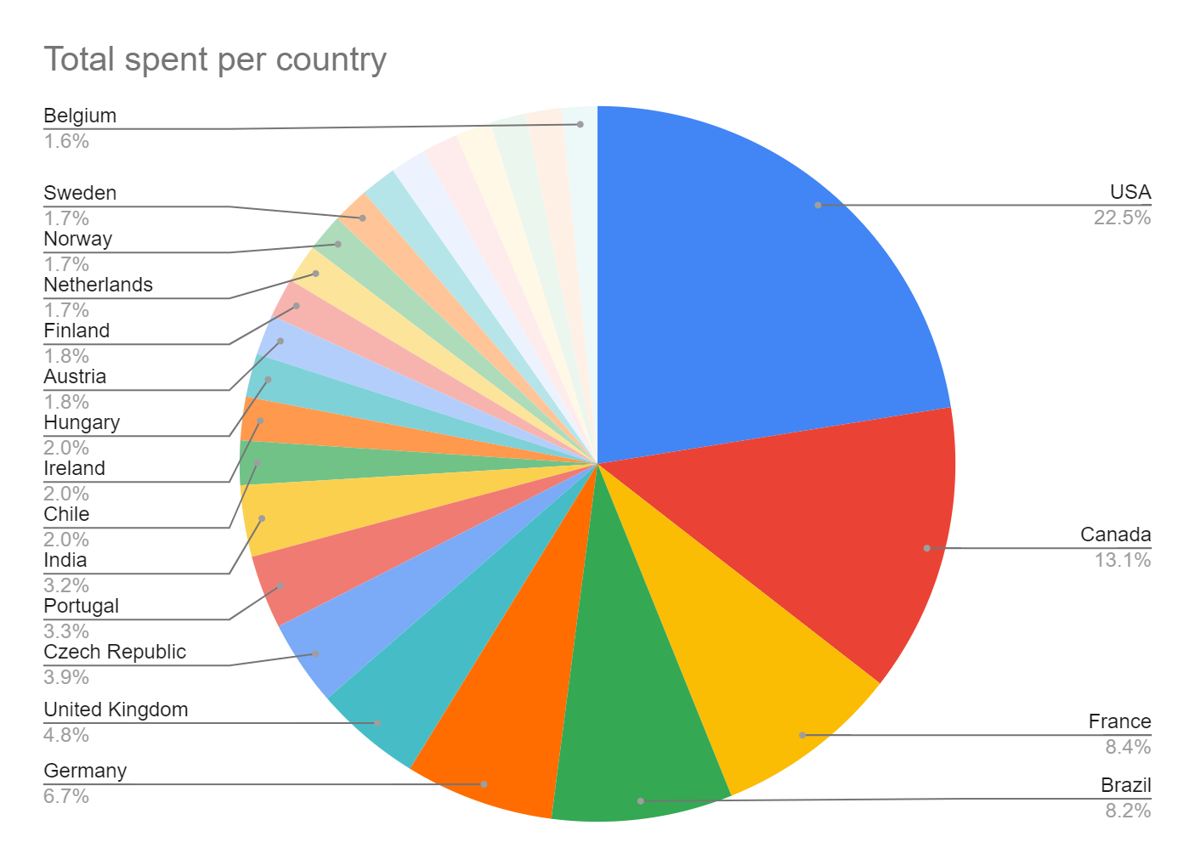
What is the total spent per country?
<visualization>
The USA has almost a quarter of the contribution, Canada has One eighth while the rest of the countries have a much lower contribution.

Slide 2
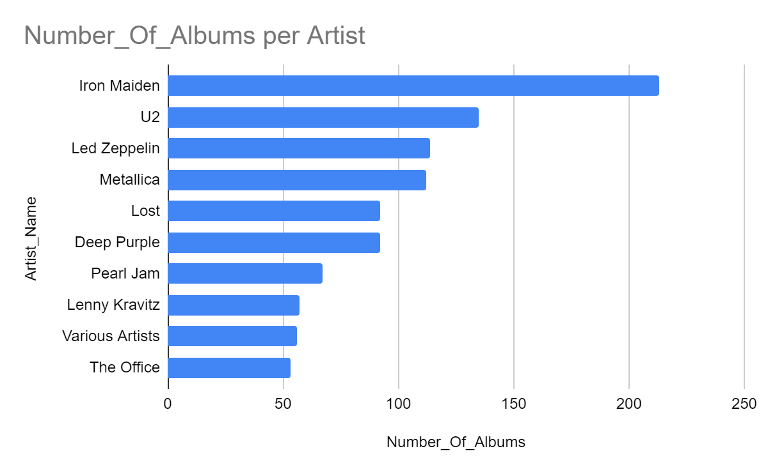
Top ten actors in terms of number of albums
<visualization>
The Artist with the highest albums number is "iron maiden" with 213 albums, then in second place U2 with 135 albums.

Slide 3
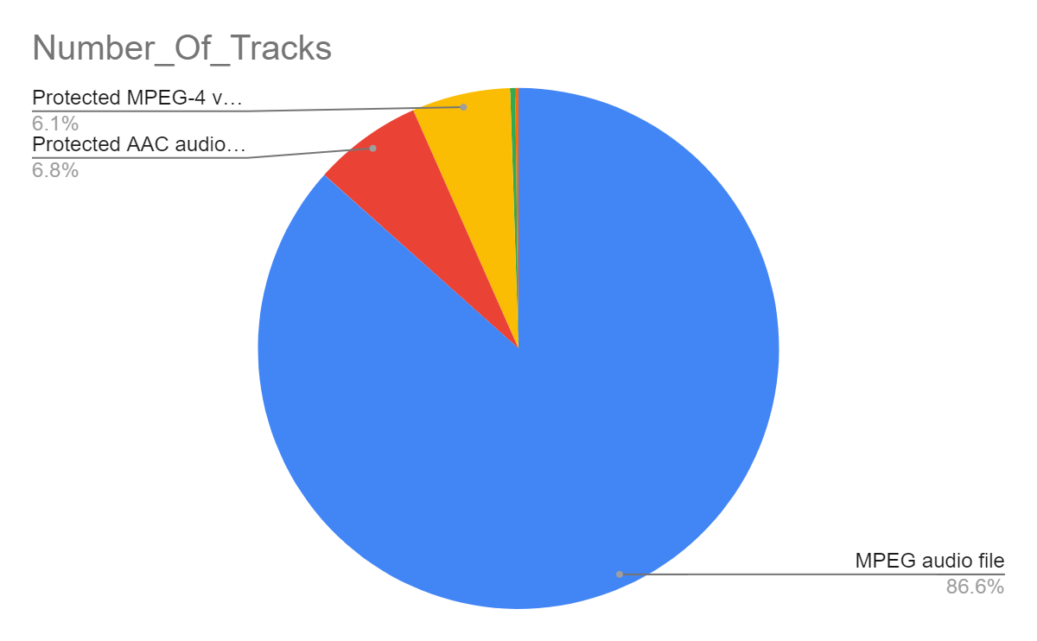
What is the most dominant media type?
We can easily notice, the most dominant media type used in the MPEG audio file with 86.6%.

Slide 4
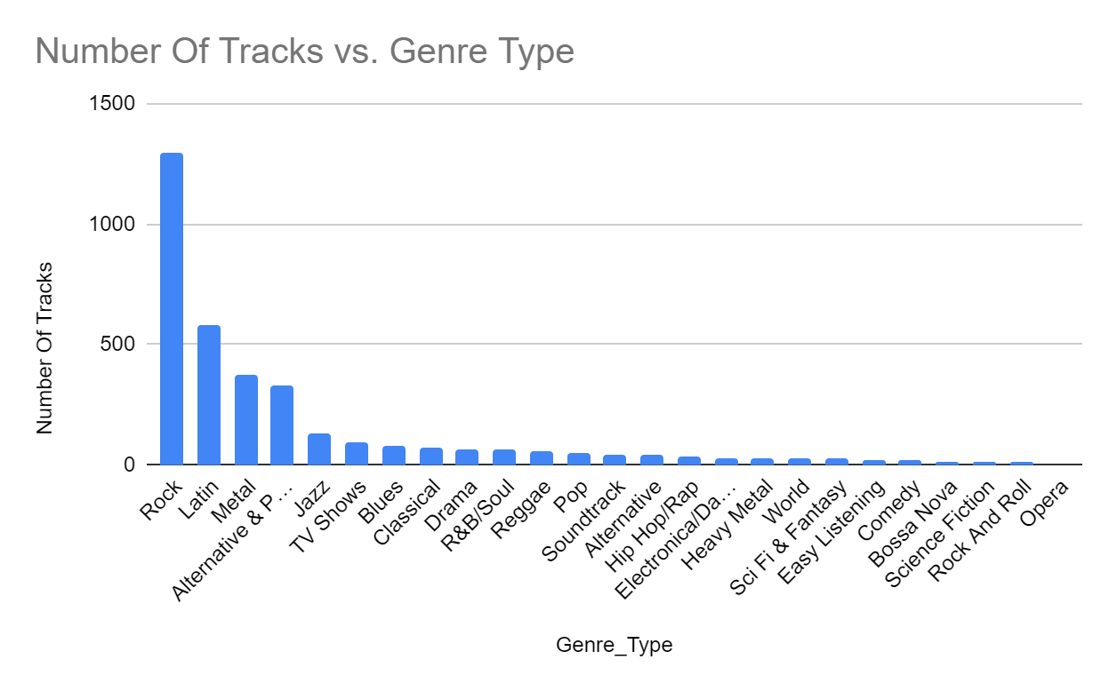
what is the most popular genre?
<visualization>
as we notice rock, Latin, mental, and Alternative & Punk are much popular than others.

